Slide 1



FACE RECOGNITION WITH THE HELP OF IMAGE CLASSIFICATION
K. J. Somaiya College of Engineering
(Autonomous College Affiliated to University of Mumbai)
Group Members
1813086 – SANKALP JAIN
1813090 – BABITA RATUDI
1813103 – SUPARSHWA PATIL
Faculty Guide
Prof. Ruchira A. Jadhav

Slide 2


TIMELINE OF PROJECT
Formation of group & deciding the topic(problem statement)
Incorporation with Flask (Backend) and designed the UI (Frontend)
Worked on ML structure (model)
Final Report of Mini Project
February (1st Week)
March
(3rd Week)
April
(3rd Week)
January (3rd Week)
March
(1st week)
April
(2nd Week)
May
(1st Week)
Doing research on the decided topic
Intermediate Report
Minor changes, debugging and making UI responsive

Slide 3
PROBLEM DEFINITION
Face recognition technology can be used in wide range of applications such as identity authentication, access control, and surveillance.
Interests and research activities in face recognition have increased significantly over the past few years.
We wanted to create on a project that can help identification of human beings/personalities and the same ideology can be applied on objects, animals, birds, plants etc. which has many real-time applications in the world.
Statement: Given image of a celebrity, identify or verify the person in the images using a stored database of faces.
Analysis: A complete face recognition system includes face detection, face preprocessing and face recognition processes. Therefore, it is necessary to extract the face region from the face detection process and separate the face from the background pattern, which provides the basis for the subsequent extraction of the face difference features. Face recognition of the separated faces is a process of feature extraction in order to obtain the identity of human faces in the images.

Slide 4
OBJECTIVES
The user should be able to input a celebrity image on the website to get proper identification.
Implementation of machine learning algorithms in real life projects with decent accuracy.
Extraction of images for training and testing using image scrapper.
Data cleaning, preprocessing of raw dataset.
Implementation of feature engineering is performed on the raw dataset.
Learn how Image classification is done using OpenCV.
Execution of various ML supervised learning classifiers.
Incorporation of machine learning models on the responsive website.
The website should be easily accessible by users with a clean user interface. People from any age should be able to use the website.
The system should satisfy the requirements precisely to fulfil the end user objectives.

Slide 5








Logistic Regression
STEP 01
STEP 03
Data Collection
Data
Preparation
Choosing a Model
Training
Random Forest
SVM
STEP 08
Save the Model
Parameter Tuning
Prediction
Evaluation
STEPS TO DEVELOP MACHINE LEARNING APPLICATION

Slide 6



INPUT
FEATURE TUPLE
FRONTEND
PYTHON
FLASK
ML MODEL
.pkl file
OUTPUT PREDICTION
PREDICTION
USER SPACE
SERVER SPACE
BACKEND DEVELOPMENT & IMPLEMENTATION

Slide 7
IMPLEMENTATION
S1: Collection of data
S2: Reading image of celebrity
S3: Image manipulation with rgb2grey
S4: Analyse the collected data
S5: Preparation of input data
S6: Split into train and test sets
S7: Training & Testing the algorithm
S8: Test for different algorithms
S9: Analyse the results
S10: Score model
S11: Saved the model
S12: server.py
S13: scratch.py
S14: wavelet.py

Slide 8
S3: RGB-Grey
S2: Reading the image
S4: Preparation of Input Data

Slide 9

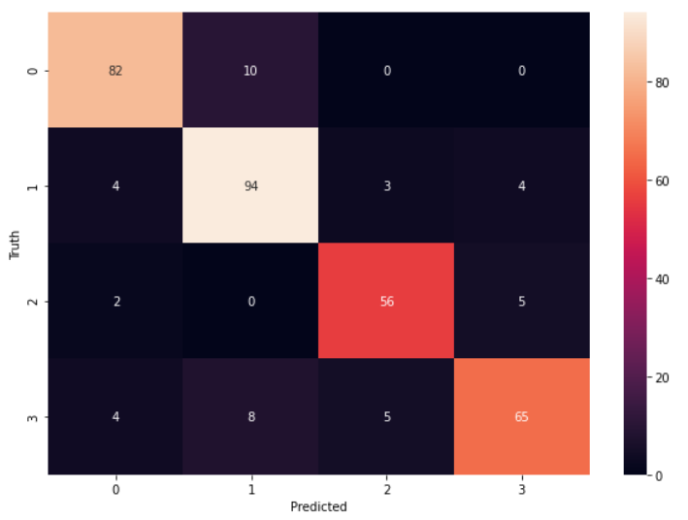
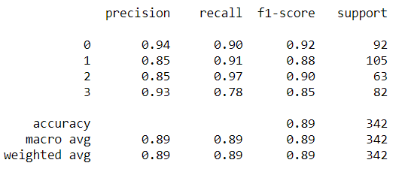
OBSERVATION & RESULTS
ACCURACY
SCORE MODEL
HEAT MAP

Slide 10
FUTURE SCOPE
The idea of project can be used for recognizing criminals from the database of police.
The idea of the project can be extended to Historical figures/personalities or Hollywood celebrities in addition with Bollywood celebrities.
The idea of project can be used for educational purposes in museums.
The idea can even be extended to animal hospitals, agriculture-based industries to detect agro based products, breed of animals, flowers and related details effectively which may save a lot of time.
It can be implemented for bio-medical report identification.
This project can be updated to identify multiple faces in a single photo and provide the corresponding results for all the detected faces.
Face Authentication can also be implemented for security purposes as well as for general use like attendance for colleges, meetings etc.

Slide 11
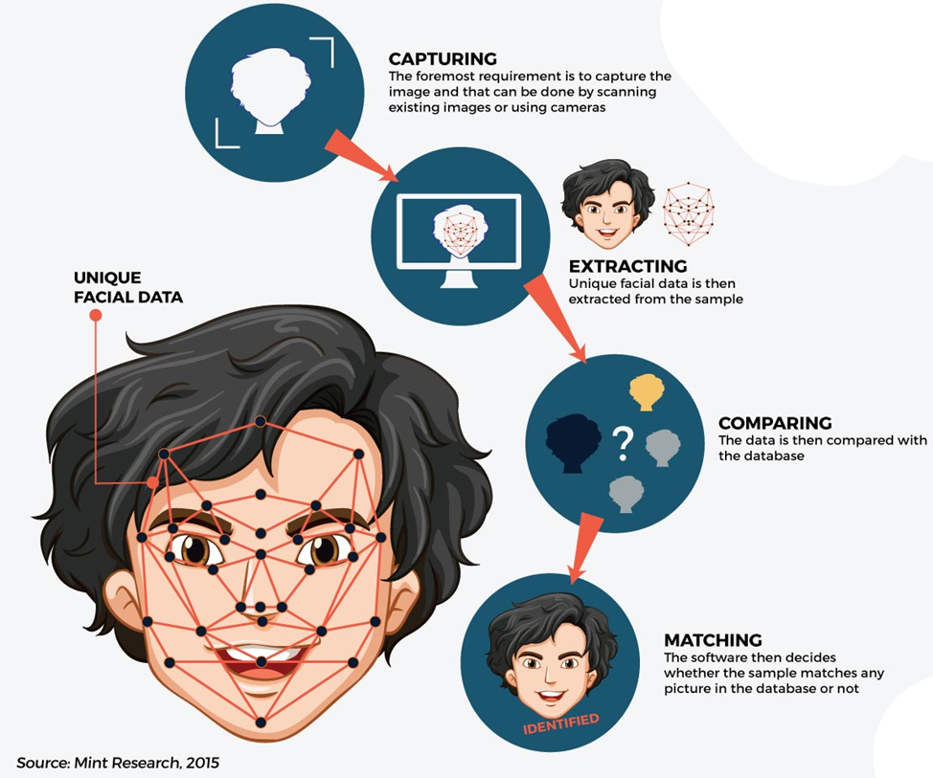






WORKING OF FACIAL RECOGNITION
https://theaseanpost.com/article/using-facial-recognition-tech-combat-terrorism-0

Slide 12
PROBLEMS FACED WHILE IMPLEMENTATION
Image Dataset: It was difficult to web scrap hundreds of images as it required drivers like Selenium etc. for downloading.
Sol: DuckDuckGo, internet search engine was incorporated with python for web scrapping.
Data Preparation: Identification of facial features of the cropped image.
Sol: Different Haarcascades were used for identification of facial features.
Data Analysis: Deciding which facial features to consider while analyzing.
Sol: After researching, it was decided to focus on features like face, eyes.
Python interpreter was not detected in PyCharm.
Sol: Python V(3.8+) should be installed and add it to path of different environment variables.
Making the website responsive and user friendly.
Sol: Bootstrap grid was implemented for making the website responsive.

Slide 13
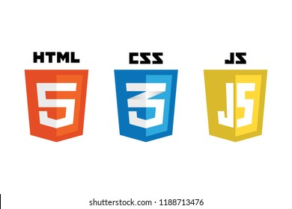








SKILLS LEARNT AND IMPLEMENTED
SOFTWARES USED

